Slide 1
Friday 9th January 2021
Our focus today is handwriting.

Slide 2
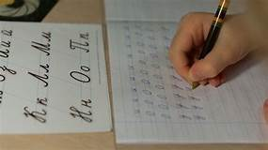
Handwriting practice – single letters that your child has difficultly forming.
Use paper, pens, chalk, sand, salt, flour
Parents please check letter formation
In resource file literacy
You could encourage them to focus on the letters.
o r u w i
Practice tricky words her,all

Slide 3
Please remember to read daily.
ONLINE SUPPORT -Phonic/ Reading apps available -
FREE APP -https://www.teachyourmonstertoread.com
FREE for a month -https://readingeggs.co.uk/
Remember to hold your pencil in the pincer grip !

