Slide 1
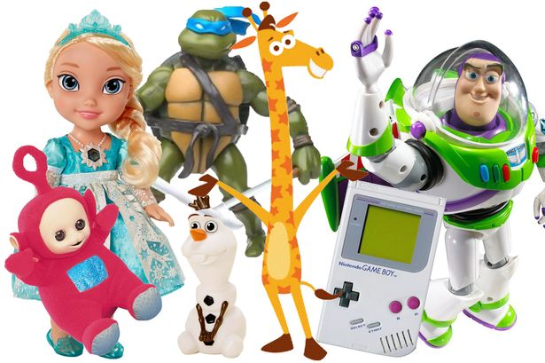
Thursday 7th January 2021
Today we want you to think about your favourite toy again.

Slide 2
Today you are going to write about your favourite toy. Before you start to write -think about when you got it?, who gave it to you?, where it came from?, what it looks like ?, how it feels?, if it smells?
Encourage your child to use descriptive language such as – smooth, soft, hard, turns, rolls, moves backwards/ forwards …

Slide 3
Please remember to read daily.
ONLINE SUPPORT -Phonic/ Reading apps available -
FREE APP -https://www.teachyourmonstertoread.com
FREE for a month -https://readingeggs.co.uk/
Don’t forget to use capital letters, finger spaces and full stops!

