Slide 1
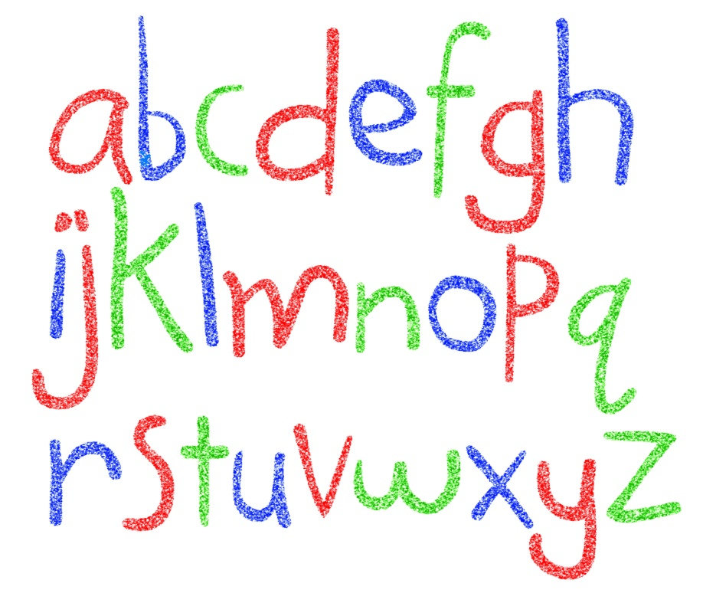
Music- linked to phonics
Listen to and learn the alphabet song.
Ensure children are saying Z and not zee

