Slide 1
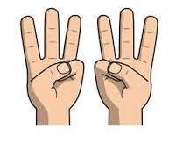
Wednesday 6th January 2021
Warm up.
Play -Fingers, fingers hide away
Adult to say
Fingers, fingers, hide away how many fingers come to play..
How to play
Ask your child to put their hands behind their back.
Adult to say a number between 1 and 10
Children to show that many fingers

Slide 2
Adding 2 groups –introducing a number sentence
+
=
2 + 2 = 4

