Slide 1
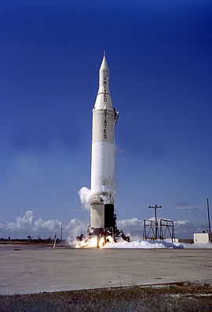
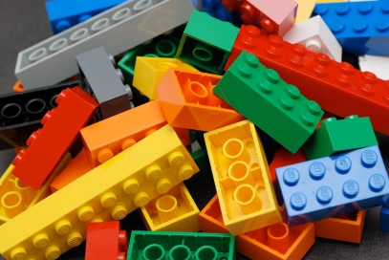
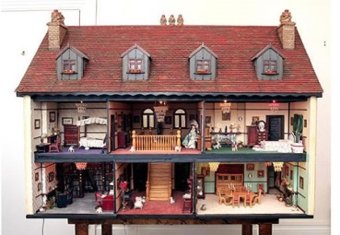
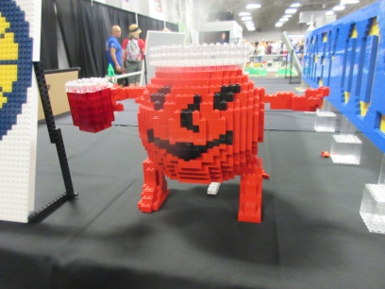
Expressive Arts and Design
Design a toy using
construction e.g. Mobilo, Lego, Duplo, blocks. First draw it then make it.
Ideas- a rocket,
boat, chair for a doll, car, unicorn

