Slide 1
Understanding the World
Winter
Vocabulary
Season
Summer
Autumn
Winter
Spring
Cold
Ice
Icicle
Snow
Frost
Dark
Chilly
Freeze
Melt
Hat
Scarf
Gloves
Coat
Boots
Go for a walk or look out of the window
Talk about the changes in the weather from Autumn to Winter.
Has it got hotter or colder?
What clothing would you wear in Winter?
What has happened to some plants, why do you think this has happened?

Slide 2
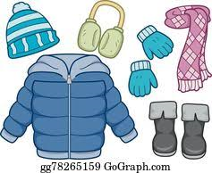
Draw items of clothing you might wear in winter.
Have a go at labelling them. Remember to use your phonics.

