Slide 1
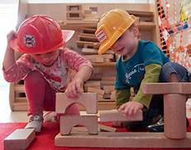
Day | 09.00-0945 | 09.45-10.05 | Break 10.05-10.50 | 10.50-11.20 | 11.20-12.00 | Lunch 12.00-13.00 | 13.00-13.30 | Break 13.30-1415 | 1415-14-45
Monday | Do some exercise. |  | Free Play |  |  |  |  | Free Play | Wider Curriculum
Tuesday | Do some exercise. |  | Free Play |  | Wider Curriculum |  |  | Free Play
Wednesday | Do some exercise. |  | Free Play |  |  |  |  | Free Play | Wider Curriculum
Thursday | Do some exercise. |  | Free Play |  | Wider Curriculum |  |  | Free Play
Friday | Do some exercise. |  | Free Play |  |  |  |  | Free Play | Wider Curriculum

