Slide 1
Friday
The children can use this card as a prompt for writing their sounds

Slide 2
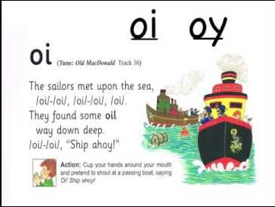

Slide 3
Must do
oi
Introduce ‘ oi ‘ sound
Say the sound, do the action
Listen to the sounds as the adult says the words boil, coil, coin, foil, join, oil, poison, soil, tinfoil, toil
Write the words on cards and encourage your child to read them independently.

Slide 4
Should do
Introduce the sound ‘oi’
Say the sound, do the action and write it down.
Hear the sound in the words:
boil, coil, coin, foil, join, oil, poison, soil, tinfoil, toil
Children to read them, blending carefully
Look in books together to spot any more ‘ow’ words.

Slide 5
Could do
oi
Introduce the sound ‘oi’
Practise the sound and song
Introduce the words below
children should read them
boil, coil, coin, foil, join, oil, poison, soil, tinfoil, toil
Add others you may know
Write one of the above words in a sentence.
E.g. The soil is brown and wet.

